Slide 1

Standby Generator Basics
WØON

Slide 2
I want a generator but have no idea what I need
It is about money, convenience and maybe local regulations.
The fuel consumption is like 0.6lb/HP/h, so even with a small generator say 3 KVA it can cost tens of
dollars a day. As fuel cost rise and supplies dwindle in an emergency, this is something to think about.
Local government regulations limit how much fuel you can store in the back yard, how much noise, how
much fumes (according to urban, industrial, rural etc.).
If you want to run the whole house, you have to go around and list everything there, and get its power
rating in Watts. If there are appliances with a motor more than 5-10 HP (unlikely except big airconditioner)
there may be special starting needs, and you need to consult a qualified installer. These
larger motors won't work with the smaller generators.
By adding up your house hold loads you can determine what is important to you. It will be between
availability of fuel, cost of operation, cost of equipment and the basics of living. If you want power for all
the appliance loads, it will guarantee a big expensive generator that may run under-loaded much of the
time. This may not be the best approach. There is a price for maximum convenience.

Slide 3
Doing without
Next you may want to decide which of the appliances will run concurrently, which you will not use. You
will need the basics, such as water (well pump), sump pump, heat in winter, power to gas stoves and
power for an electric burner. It will be heaters, air-conditioners, stoves, driers, hot water that you can
marginalize. Make a plan for what lights can be used and what is necessary for you to live.

Slide 4
Essential System
For a system without air-conditioners / heaters, I would start at 3-5KVA for the essentials, add more as
you deem fit.
Essential is refrigeration and some lights, and a microwave oven for most people. Maybe some TV,
phone and computer stuff. This will generally run from 3 to 5 KVA. The microwave (say 1500W) and
the refrigeration don't have to run at the same time, except for convenience. The cooking can be done by
gas (barbecue, camp stove etc). A kettle is 2.4KW, so it hogs close to the full output of a smaller
generator, you would have to turn everything else off except a light or two.
Larger sizes than around 5 KVA are not so much for essentials but convenience and comfort. If you need
power to run air-conditioning or heaters, add that on. All of the units that must run together. The others
will be disabled. There is no sharing, in that the generator must run all of them concurrently some of the
time. The sharing (when thermostat is off) is in the lower fuel usage.

Slide 5
Total power needs
Once you arrive at a total figure you need to add a bit more to allow for unforeseen, surges etc.
Allow 10% extra to the KW to allow for errors. Most generators have a surge rating that should accommodate small air-conditioners, but for large ones that are most of your KW rating, get consultation.
They may need three phase, special wiring, whatever. If there are several air-conditioners, hopefully they have timers so they all start at different times when first powered up. Otherwise you turn them on one at a time.

Slide 6
Electrical horsepower
The horsepower used for electrical machines is defined as exactly 746 W. The nameplates on electrical motors show their power output, not their power input. Efficiency is defined as output divided by input.
Assuming that the motor is 86% efficient and assuming the output is 1 or unity. The output of 1 is divided by .86 to find that an input of 1.16 is required. We can use this unit factor of 1.16 to find the minimum Horsepower (HP) required to drive any generator we are looking at. It doesn’t account for all losses from the engine to the generator but does give us a good ball park figure to work with.
Let say we see a 3 KW generator and we need to know if it has a larger enough engine to drive it to max.
  The minimum HP to drive that generator is (3,000 X 1.16) / 746 = 4.66 or 5 HP power. Now we know it will handle the generator and some room for surge.
  If we know the HP and we want to know how many watts it can drive we simply work it as:
    Watts = (HP of engine X 746) / 1.16
    Say we see a 16HP engine so we can determine that it will drive:
    Watts = (16 X 746) / 1.16 = 10,289 watts or 10 KW
  If we see a 16HP engine on a 8KW generator we know that we have plenty of reserve for peak loads.

Slide 7
Understand generator ratings
Finally, remember that the sum is KW. Buy a generator with at least that KW rating, or add 25% if you
buy by the KVA rating (assumes the generator is rated for 0.8 PF). This is important, because the engine
is probably the KW rating (20% less than the KVA rating).

Slide 8
How you use it
Be aware that even small generators make a lot of carbon monoxide (CO), extremely toxic. People have died running them outdoors but near open windows.
It can be connected to the whole house by a change-over switch near the meter box. This is best done by an electrician. Have a ground bond for the generator. More than one ground stake is good. Put a current balance safety switch near the generator. This will not necessarily protect against faults in the generator making the frame alive. Have good insulated mats to stand on is cheap back-up insurance
There should be an overload circuit breaker near the generator too. You can buy combined overload and safety switch with a couple of outlets for small generators - builders need them.
The whole house setup can be a nuisance with small generators, especially if you have kids. In this case you can just run out a cable to the kitchen, then a distribution board with outlets for fridge, microwave and a couple of stand lamps or desk lamps. A lot of people only run it enough to keep the fridge cold.
Have alternative lighting, torches, etc. Small generators often don't have enough fuel tank for 24 hours run. You need to stop them for refueling, so need lights. The sine wave inverter types are better in that the RPM can vary, they generate correct voltage and frequency and automatically speed up for bigger loads, save fuel that way. Always switch off then stop the engine, start the engine then switch on. Not doing this can burn small transformers out. (So never run out of fuel either).

Slide 9
Size the Electric Generator
A home electric generator is a valuable addition to just about any home, but even more so if you live in an area that suffers from extensive seasonal storms. In these areas, it is not uncommon to be without power for days at a time. Having a reliable and properly-sized electric generator will help you get through those difficult days until the power company is able to restore the electricity to your area. There is a fine line, however, between purchasing too much generator and not enough. Here is how to properly size a home electric generator.
Before you head out to the home improvement store to look for a home electric generator, you need to have an understanding of how much wattage your essential appliances are using now. This will give you an idea of what size generator will suit your needs.
One way to calculate your wattage is to use an ammeter. The ammeter is placed in-line with each appliance and it reads the amount of electricity being used by that appliance. You can purchase one and do this yourself, or you can hire an electrician to take the readings for you. Keep in mind that if you purchase the ammeter yourself, it will probably cost less than hiring an electrician and you'll have the ammeter for whenever you may need it again.
Once you have all of your appliances and their electricity usage written down, add all of the wattage up. This will be a baseline number for your generator needs. If you don't want to put out the money for either the ammeter or the electrician, you can still find the numbers you need. Each appliance has an informational label somewhere on its body. Find the label (or
look in the manuals if you still have them) and look for the wattage number.

Slide 10
Size the Electric Generator
If watts are not included on the label, find the voltage and amperage.
You can determine the watts of the appliance by using the following calculation:
volts x amps = watts
Some of the larger appliances in your home require more power to start than they do to run (sometimes as much as three times more). This is important to keep in mind when tallying your wattage needs.
  Find out which appliance draws the largest startup load and add that difference to your wattage needs.
  You don't need to add all of the startup differences, only the largest, because the appliances will not all be starting up at the same time.
Now that you have your total calculations, add another 20 percent to the number.
  This will allow your generator a little breathing room and you'll have the power necessary if you add any smaller appliances at any point in the future.
  It will also help your home electric generator to last longer because it won't be working as hard.

Slide 11
Generator Tips & Warnings
Choose only from among generators that adhere to emission regulations and feature certain safety features like automatic shut-offs in case of overheating or oil pressure loss.
Don’t let the generator run out of fuel.
Use a combined overload, safety switch and outlet box.
For electronics, be safe and use a generator with a built in sine wave inverter.
If you use both 120 outlets or the 220 plug, use a current balance safety switch near the generator.
Turn your generator off and let it cool down before you fuel it.
Check the generator voltage before you plug into it.

Slide 12
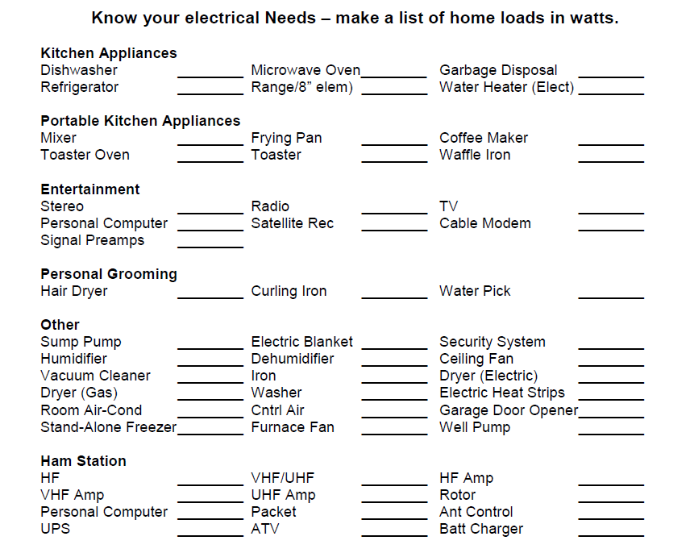
Know your electrical Needs
Make a list of home loads in watts

Slide 13
Know Your Requirements
It is always better to dive deep into your power generation requirements before making a choice. You can do this in the following ways:
  Make a list of the items that need to be powered by the generator
  Make a note of the starting and running wattage of the respective items; see power consumption chart.
  Calculate the total power requirements in KVA or KW

Slide 14
How to Find the Starting and Running Wattage
Getting the right starting and running wattage of the devices you intend to power is crucial for calculating the accurate power requirements.
Normally, you will find these in the identification plate or the owner’s manual in the buyer's kit of each respective device, tool, appliance, or other electrical equipment.

Slide 15
Ampere - Watt Conversion
When working with generators you are working with AC. In this case you are working with AC at 60 Hz.
You may often find power requirements of tools stated in amperes. Use one the following formulas:
  For resistive load: Wattage = amperes x volts
  For reactive load: Wattage = (amperes x volts) x load factor
A load factor is what we call a Power Factor.
The Power Factor (PF or pf) is a number between 0 and unity or 1 and is generally expressed as a percentage. A PF = 0.8 would be 80%.
If the label shows PFC of 98%, it means that the equipment’s Power Factor has been Corrected to 98%.
A PF is either linear or non-linear. Linear means the circuit is passive or nearly resistive and a non-linear means it has non-linear devices that represent the load.
For our purpose we will assume all will be non-linear and we are not going to worry about if it is leading or lagging.
All we care about at this point is what to do with a label that has a PF or a PFC. For our purpose we will treat both the same and call it load factor.

Slide 16
Power Requirement Charting
It often happens that you lose the owner's manual or for some reason can't find the power requirement specification of the tools and/or other electrical devices you're running.
Here is a sample power consumption chart that demonstrates some of the typical wattages used for common appliances and tools.

Slide 17
Motor Starting Loads
Motors that give run current but do not give starting current can be added with a simple rule of thumb.
Multiply the running current by 7 to get the peak starting current. This is a good safe value to use.
Starting Wattage = Voltage X (Running Current X 7)

Slide 18
Power Consumption Chart
This chart is provided as an example as to how wattage varies between various electrical devices. It is not
meant to be a strict guide to calculate your requirements. For the most accurate calculations refer to the
owners manual of each device, tool, appliance, etc., or most preferably, consult a professional electrician:

Slide 19
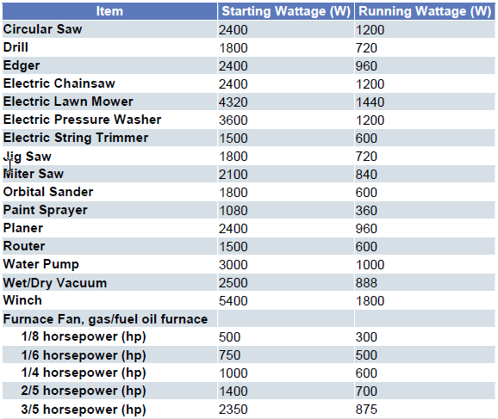
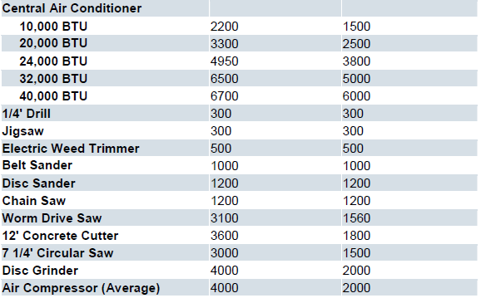
The chart is simply provided as an example to demonstrate how starting and running wattages differ, and how each device has specific consumption needs. If you have questions over any particular items you can contact the manufacturer or consult an electrician.

Slide 20
Different ways of Calculating
Depending upon the type and number of devices, and the way the generator is scheduled to be used, there are a few different ways of calculating power requirements:
  Single motor running (Furnace Fan Running)
  Multiple motors running simultaneously (Fan and Freezer running)
  No electric motors.
  Advantages of choosing the right size generator: Now that you have an idea on how to choose the appropriate size of generator to suit your needs, here's just a few of the benefits obtained by going through that process:
No unexpected system failures
  No shutdowns due to capacity overload
  Increased longevity of the generator
  Guaranteed performance
  Smoother hassle-free maintenance
  Increased system life span
  Assured personal safety
  Much smaller chance of asset damage

Slide 21
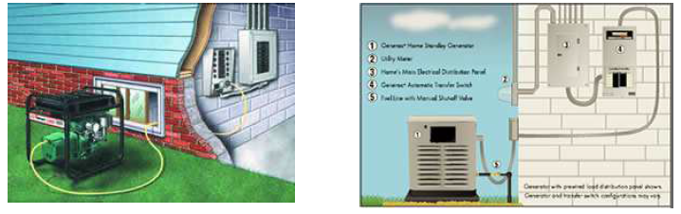
Transfer Switches
For safety's sake, hire a licensed electrician to install a transfer switch that distributes power from the
generator to the home's circuit box. This reduces the need for multiple extension cords running from the generator to specific appliances, and eliminates the risk of electrical "back feed" injuring utility workers working on downed power lines.
The transfer switch (around $150 and up) is installed beside the main electrical panel, and then it's
connected to circuits you'll need during a blackout. When the power goes out, you simply crank up the
generator and run a single extension cord from it to the transfer switch.
Once the generator is running, you can choose which circuits you want to use by flipping the switches on the transfer switch.
It's important to keep track of what's being powered because the transfer switch is often wired into more circuits than the generator can handle all at once. This unless you add another circuit breaker box and transfer the loads you can power to it. Then you know when power is restored and the generator is safe to shut down. Everyone is protected.

Slide 22
Transfer Switches
A typical transfer-switch installation will take less than two hours and cost around $100-$200, but it's an investment that will be fully appreciated the next time the power goes out.
Make your installation simple so all family members can use the generator safely.
Make an instruction sheet and put it with the generator so family members know what to do to restore power.

Slide 23
Decide What You Need
The first step in picking a home standby generator is to determine if you want to power your whole house, essential circuits or somewhere in between. One of the biggest misconceptions about home standby generators is that they restore power to the entire house.
The term "whole house" is really dependent upon the size of your house. If you want to power a doghouse, a small camping generator will work.
If you own a luxury home, you'll need a massive generator. Whole house generators are the ideal solution because they power … surprise … the whole house. Unfortunately, they aren’t cheap.
For example, the smallest whole house generator - a 25-kilowatt liquid-cooled generator -- starts around $7,500 for just the generator. The transfer switch isn't even included.

Slide 24
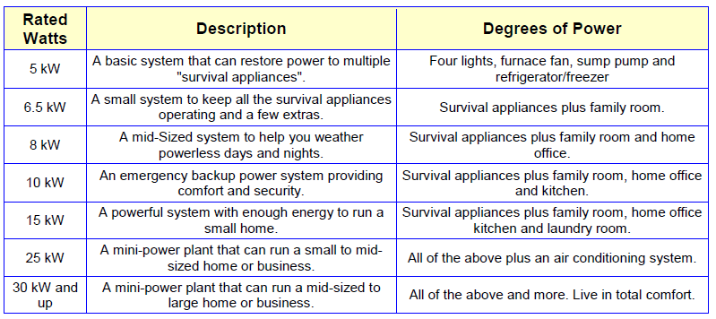
Decide What You Need
The following chart quickly summarizes how much electricity various power generators can produce.
It's very important not to run too many appliances at once and overload your emergency power source. As a general rule, the total running (rated) and starting watts of all the appliances being used at one time should not exceed the power source's wattage.

Slide 25
Portable Generators
A growing number of Americans are converting their portable gasoline generators into emergency backup power systems.
The minimum size recommended for home-emergency use is a 5,000-watt generator (starting around $600), which can power multiple appliances for 8 hours.
Portable generators are available on our site and can be shipped anywhere around the country. Retail stores carry them also but they become scarce during a blackout and often it is difficult to find the cords, plugs, transfer switches and other parts needed.
Most generators sold in hardware stores are low quality, price cutting types of units. Several brands of portable generators are VoltMaster Honda, Yamaha, Baldor, Winco, Onan, Robin and others.

Slide 26
Extension Cords
The most common way to use a portable generator is to place it outdoors, then run an extension cord(s) through an open window or door to the chosen appliance. This approach works well for smaller generators because you can only plug in one or two items.
You must connect the item directly unless you use a transfer switch. A combined overload and safety switch is recommended.
NOTE: You cannot run a generator indoors, not even in the garage, because a generator makes carbon-monoxide which is odorless and color-less and it can kill you and your family. Be sure to use appropriately sized power cords to carry the electric load. If you use an undersized cord, you can potentially damage the generator and appliances. The rating is printed on the generator outlet.
Extension cords are rated by "gauges." For example, the most common size for generator use is 14, 12 and 10 gauge. The smaller the gauge number, the thicker the cord and the more electricity it can carry.
  14 AWG = 15 amps
  12 AWG = 20 amps
  10 AWG = 35 amps
  8 AWG = 40 amps
Extension cords have several other drawbacks. First, most extension cords can't be plugged into a furnace, well pump, or ceiling-light fixture. And, if they are placed under rugs or carpets, heat can build up and spark a fire.
If you can’t plug into the extension cord or generator directly into the main, you must use a transfer switch.

Slide 27
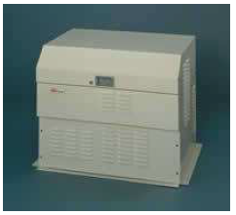
Home Standby Generators
If you want the convenience, security, and comfort of a generator but don’t
want to venture out in inclement weather to get it started, you might want
to consider getting an emergency standby generator.
These personal power plants supply electricity to the majority of your
house, not just to a few selected circuits. The all-weather generators are installed outside like a central air conditioner and are wired through an automatic transfer switch to the main electrical panel.
The units run on natural gas, propane, or diesel fuel. Some systems can even be connected to a home’s natural gas line, eliminating the need to fill fuel tanks.
When the power goes out, there's a slight delay of 15 to 20 seconds, then the generator automatically kicks on - whether you're home or not - and continues running until power is restored, when it will
automatically shut off. If you have critical applications such as life support equipment, computers or similar systems, you can install a UPS (uninterruptible power supply, a battery in a special box), and there will be no interruption of power to these devices while the generator starts up.

